Slide 1
Speaking and Language Functions
Faeza Adnan Salih
University Lecturer
faezasalih@uobaghdad.edu.iq

Slide 2
Agenda
------------------------------------------------------------------------------------------------------------------------------------------------------------------------
What are functions of language?
What are the main types of language function?
How can we use language functions in speaking?

Slide 3
Language Functions
Language function is a part of the language. Each language has its function, which is used to communicate.

Slide 4
Types of language functions
Informative
Directive
Expressive

Slide 5
Functions of language

Slide 6
Compare and Contrast
1. Determiners
Words such as both, all, neither, and none can show how two items are the same
Both Asia and Europe are continents.
Neither boy plays football.
2. Adverb and adverb phrases
Words such as in common, as well, also, in the same way, so do, like and likewise
Jason is an optimist. Jude is an optimist, too.
Jason and Jude have being an optimist in common.

Slide 7
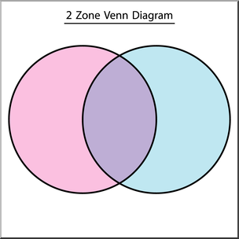
Compare and Contrast
3. Linking expressions
When we evaluate two things using comparative adjectives, we must necessarily put both of those items in the same phrase.
Asia is larger than Europe.
Asia is huge whereas Europe is small.
Jason is more optimistic than Jane.
Jason is an optimist, but Jane is a pessimist.
Jason is an optimist while Jane is a pessimist.
Although Jason is an optimist, Jane is a pessimist.

Slide 8
Compare and Contrast
4. Nouns and verbs
Adjectives are great ways of comparing two items, but you can also use nouns and verbs to show similarities and differences.
Some verbs that compare and contrast are differ, contrast, compare, vary, change, equate, equal, match, and parallel.
Asia contrasts with Europe in size.
Jason and Jude match in temperament.

Slide 9
Compare and Contrast
4. Nouns and verbs
Some nouns that compare and contrast are difference, similarity, contrast, comparison, variance, dissimilarity, change, resemblance, likeness, parallel, connection, and match
The temperaments of Jason and Jude are a match.
Asia and Europe have a dissimilarity in size.

Slide 10
Compare and Contrast
5. Degrees of similarity
The following phrases express degrees which can be combined with an adjective to say just how similar or different two items are:
absolutely the same/different, exactly the same, practically the same/opposite, basically the same/different/opposite, nearly the same, more or less the same/different, quite similar/different, completely the same/different, totally the same/different, slightly similar/different, and very similar/different.
Juan is slightly different than Kevin.
Abdul and Hind are opposite in their speech volume.

Slide 11
Ask for Something
Excuse me. Could you tell me where ... is?
Excuse me. Can you tell me...?
Do you know...? You wouldn't know..., would you?
Do you happen to know …..?
I'd like to know..., please. And there's another thing I'd like to know...
I would be interested to know...
Please could you tell me..
Examples:
Could you tell me when the next train leaves?
Do you happen to know when Sandy arrives home?

Slide 12
Expressing Opinions
I think that…….
I don’t think that…….
I’ve always thought that ……
In my opinion, …….
From my point of view, …………….
As far as I’m concerned, ………..
I strongly believe that……….
I have my doubts about ……….

Slide 13
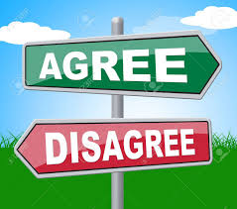
Expressing Opinions
I totally agree.
I absolutely agree with you.
I agree up to a point, but ………
I’m not sure I agree with that.
I don’t really agree.
I don’t agree at all.
Actually, I disagree with you.
I completely disagree.

Slide 14
Expressing Opinions
Let me see…..
Well, I mean……..
It depends, really ……….
I think that depends on various things….
I’m not sure, but I suppose ………
I’m not quite sure what I think about that ……..
I’ve never thought about that before…
I don’t know much about this, but I think ….
That’s an interesting question …..

Slide 15
Suggesting
Words such as should, why don’t you, ought to, If I were you, I would …, suggest, recommend
You should try to practice in English.
Why don’t you join an English club?
You ought to read more.
If I were you, I would sleep early.
I suggest visiting to the Eiffel Tower. (We should all go)
I suggest that you visit the Eiffel Tower. (I’m not going)
I recommend the Lasagne. (It’s a very good dish to choose in the restaurant)

Slide 16
Asking for Advice
Advise (v.)
I advise you to buy a good dictionary.
Advice (n.)
Uncountable noun. We can’t say an advice. Instead, we say some advice or a piece of advice
Let me give you some advice
She gave me a very good piece of advice: to buy a good dictionary.

Slide 17
Giving Advice
There are many ways of giving advice in English. Here are some common advice:
I think you should... (do).
You could... (do).
Why don't you... (do)?
If I were you, I'd... (do).
Have you tried... (doing)?
You ought to (do)…
It’s a good idea to…

Slide 18
Giving Advice
Examples
someone says "I’m having problems learning English", you could say:
If I were you, I’d sign up for an English course.
Have you thought about going to the UK for a couple of weeks?
You really ought to watch English television.
Why don’t you read more English books?

Slide 19
Refusing
I'm afraid not.
I'm sorry it's not possible...
I'm afraid I can't / don’t like.
I would rather not
Examples:
Would you like to see a film tonight?
I’m afraid I can’t go out tonight. I’ve got a test tomorrow.
Why don’t we have some Indian food?
Sorry, but I don’t like Indian food.
How about watching a movie tonight?
I’d really rather not watch the movie tonight.

Slide 20
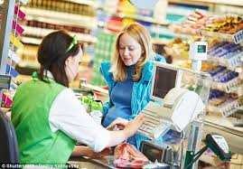
Complaining
In a shop
You are in a shop and the assistant gives you the wrong change.
Excuse me, I think you’ve giving me the wrong Change.
Sorry, I think this change is wrong. I gave you $20, not $10.

Slide 21
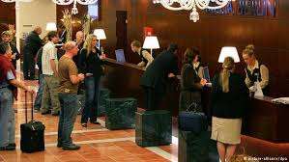
Complaining
In a hotel
Excuse me, but there's a problem with the heating in my room.
Sorry to bother you, but I think there's something wrong with the air/conditioning.
I'm afraid I have to make a complaint. Some money has gone missing from my hotel room.
I'm afraid there's a slight problem with my room / the bed hasn't been made."

Slide 22
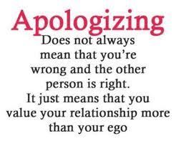
Apologizing
Sorry I'm very/awfully/so/extremely sorry.
Excuse me. Sorry, (it was) my fault.
I do apologize.
Please accept my apologies.
I’m sorry but....
I apologize for…but…
Forgive me for… but …

Slide 23
Making Requests
Asking someone to do something for you
Could you open the door for me, please?
Would you mind opening the door for me, please?
Can you open the door for me, please?
Speaking tip:
Could and Can are followed by the verb without to.
Would you mind …. is followed by the verb and –ing.

Slide 24
Making Requests
Asking if you can do something
Can I use your computer, please?
Could I borrow some money from you, please?
Do you mind if I turn up the heating?
Would you mind if I turned up the heating?
Speaking tip:
Could is more polite than can.
Do you mind if…. is followed by the verb in the present tense.
Would you mind if ….. is followed by the verb in the past tense.

Slide 25
References
Functional language. Asking/giving for an opinion (2018). Retrieved from https://busyteacher.org/11943-functional-language-givingasking-for-an-opinion.html
Hayat, T. (2018). Language functions in English and vocabulary. Retrieved from https://www.scribd.com/doc/16389593/Language-Functions-in-English
Hill, J. D. & Miller, K.D. (2013). Classroom instructions that work with English language learners. Retrieved from http://www.ascd.org/publications/books/114004/chapters/Academic-Language.aspx
Teaching language functions (2016), Retrieved from https://www.ukessays.com/essays/teaching/teaching-language-functions.php
Verner, S. (2018). Going beyond-ER: five advanced techniques for comparing and contrasting in English. Retrieved from https://busyteacher.org/23668-compare-contrast-english-5-advanced-techniques.html

