Slide 7
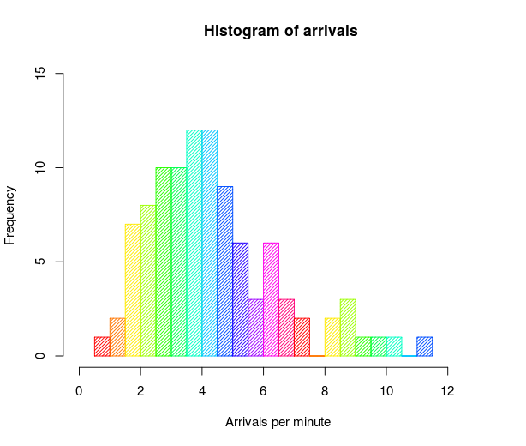
A histogram is a graphical representation of the distribution of data. It is an estimate of the probability distribution of a continuous variable and was first introduced by Karl Pearson.

Slide 8
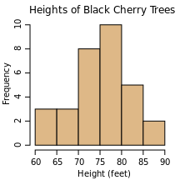

Slide 9
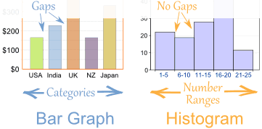
Histograms are a great way to show results of continuous data, such as:
weight
height
how much time
etc.
But if your data is in categories (such as Country or Favorite Movie), then you should use a Bar Chart.

Slide 10
Description
A bar graph is a chart that uses either horizontal or vertical bars to show comparisons among categories. One axis of the chart shows the specific categories being compared, and the other axis represents a discrete value. Some bar graphs present bars clustered in groups of more than one (grouped bar graphs), and others show the bars divided into subparts to show cumulate effect (stacked bar graphs).

Slide 11
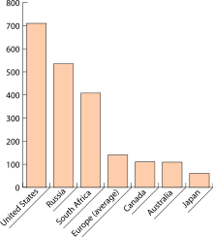
SIMPLE BARCHART
A bar chart or bar graph is a chart with rectangular bars with lengths proportional to the values that they represent. The bars can be plotted vertically or horizontally. A vertical bar chart is sometimes called a column bar chart.

Slide 12
Advantages
It can be drawn quickly
The ratios of the bars are readily seems.
Can also be used to show values of non categories such as months, different brands etc.
Disadvantage
One simple information can be shown

Slide 13
MULTIPLE BAR CHARTS
It shoes 2 or more characteristics corresponding to the values of a common variable in the form of grouped bars, whose lengths are proportional to the values of the characteristics and each of which is shaded differently to aid identification.

Slide 14
Advantages
This type of chart is useful when dealing with two or three categories
Comparing categories with in days, a year and the years.
By comparing the heights of the bars we are able to see not only the trend, but the difference between the two items (or more) for each of the specific periods of time.
Disadvantage
It is even more different to group readily the relation between two or three test of figures.

Slide 15
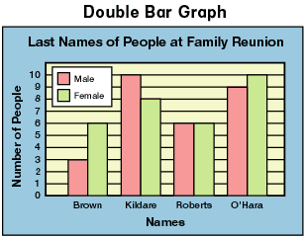
It is preferable when comparing two sets of related data and is an extension of the simple bar graph.

Slide 16
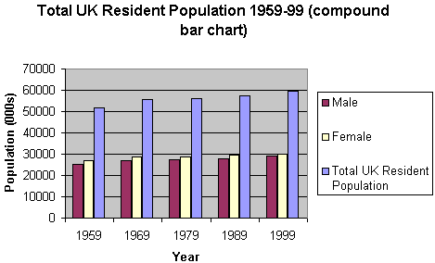
MULTIPLE BAR CHARTS

Slide 17
COMPONENT/COMPOUND BAR CHART
It is in which each bar is divided into two or more sections, proportional in size to the components parts of a total being displayed by each bar.
They are used to represent the cumulative of the various components of data and the percentages. They are also known as sub divided bars.

Slide 18
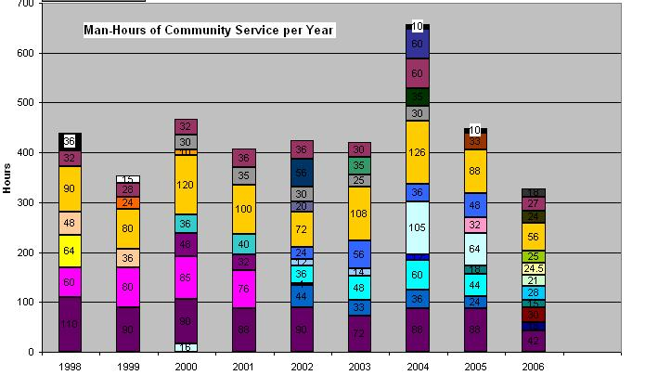
2. Subdivided Bar Chart

Slide 19
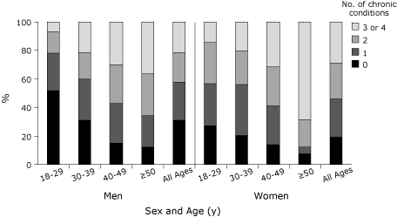
1. Sectional percentage bar chart

Slide 20
Advantages
It is generally used to compare the different sections
Disadvantages
It doesn’t show clearly the actual amount

Slide 21
PIE CHART
It is a graphic device consisting of a circle divided into sectors or pie-shaped devices whose areas are proportional to the various parts into which the whole quantity is devised
Angle = (Component part /whole quantity) x 360
For example If total number of students from UK were 10 out of 50 we will first divide 10 by 50 then will multiply it by 360 according to the formula mentioned above. In the same way we will calculate each and every thing and using these figures we will draw pie chart shown below.

Slide 22
Group Seats Percent (%) Central angle (°)
EUL 39 5.3 19.2
PES 200 27.3 98.4
EFA 42 5.7 20.7
EDD 15 2.0 7.4
ELDR 67 9.2 33.0
EPP 276 37.7 135.7
UEN 27 3.7 13.3
Other 66 9.0 32.5
Total 732 99.9* 360.2*

Slide 23
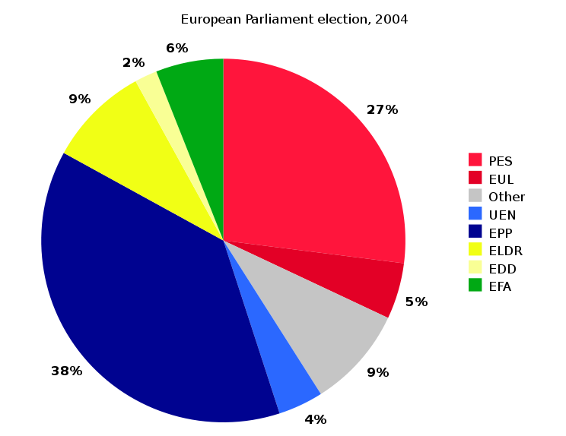

Slide 24
ADVANTAGES
• It is useful when projections التقديرات are more
important than the numerical values.
• It provides a strong visual impact.
DISADVANTAGE
• It can not be drawn quickly as bar chart.

Slide 25
COMPARATIVE PIE CHART
The set of data can be compared by using two different pie charts. The area of the circles is proportional to the total quantities they represent.
The comparative pie charts are very difficult to read and compare if the ratio of the pie chart is not given.
The r1 and r2 be, the radius of the circles which represent the total TI and T2 respectively. Then
T1/ T2 = (r1/ r2)2
This formula is applied when two pie chart similar to each other are given then we will apply formula given T1/T2=(r1/r2)2. Information is always given in the question or labeled on the pie chart.

Slide 26
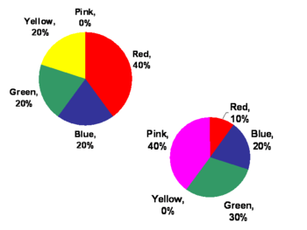

Slide 27
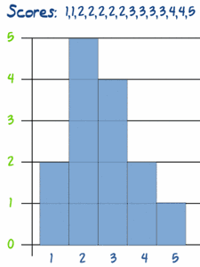
Frequency Histogram
A Frequency Histogram is a special histogram that uses vertical columns to show frequencies (how many times each score occurs):

Slide 28
Broken Line Graph
A broken line graph is a graph that represents information through points or dots, which are then joined together by lines. They are the most common graphs, and are used to represent information that changes over a period of time, i.e. the sale of products over a period of a number of years, or months, or days, etc. types of broken line graphs include the double broken line graph, and triple broken line graph.

Slide 29
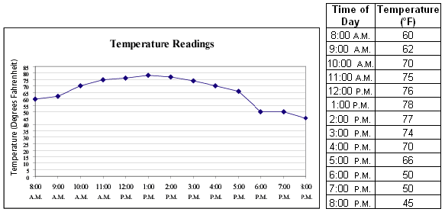
Line graph: A line graph is typically used to represent serial data (data that can be collected without gaps such as change in temperature over a time period). Typically, observations are made over regular intervals. Then, these discrete points are plotted and adjacent points are connected with line segments to indicate the serial nature of the data and allow for interpolation الزيادة.

Slide 30
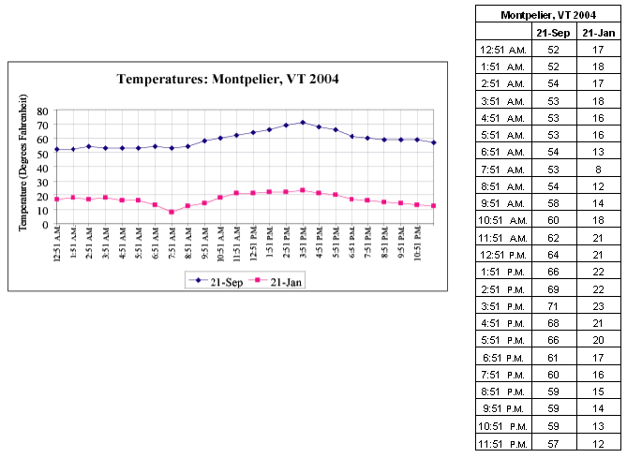
Double line graph:

Slide 31
How to Make a Broken-Line Graph in MS Excel
When we collect experimental data, we are not using the most accurate of equipment. For this reason, we construct scatter-plots and draw lines of best fit when we are graphing data.
When graphing counted data, or when we are graphing data which has been provided with the assurance that it is very accurate, we will “connect the dots” and make a broken-line graph instead.
Enter the data in Excel. Make sure the independent variable is in the
first column
Drag a box with the mouse to highlight the data, and then click the
chart icon on the toolbar.
Select XY (Scatter), and click on the bottom right chart-type, to show
the data points connected by straight lines.

Slide 32
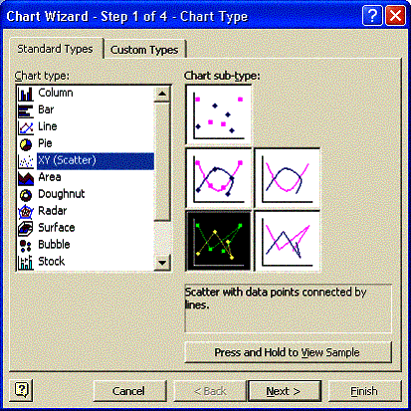

Slide 33
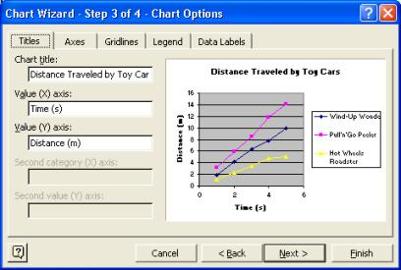
Click “Next” to bring up the Chart Options window of the Chart Wizard. Enter the title and appropriate axis-labels.

Slide 34
line plot
Another form of graph, the line plot, makes it easy to see the mean, median, mode, and range of a set of data. The line plot uses a number line and Xs to represent each number. This line plot shows these scores from the game: 18, 14, 22, 33, 7, 7, 30, 34, 30, 10, 15.
The data has two modes 7 and 30. The line plot lets you see these easily, because the numbers are represented by Xs.
The range is 34 − 7 or 27.
The median, the middle value is the sixth X, or 18.
To find the mean, add the scores and divide by the number of scores (220 ÷ 11 = 20).

Slide 35
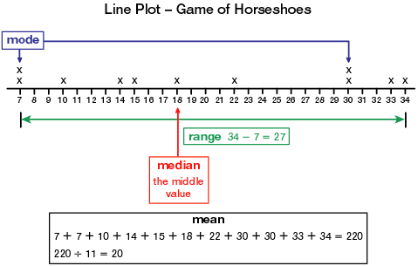
18, 14, 22, 33, 7, 7, 30, 34, 30, 10, 15.
7, 7, 10, 14, 15, 18, 22, 30, 30, 33, 34
scores from the game

Slide 36
With so many types of graphs available, students must learn how to choose appropriate types.
Bar graphs are often a good choice to show
comparisons among data.
Histograms show data that is organized in equal
intervals.
Line graphs and double line graphs are well suited
to showing change over time.
Circle graphs are well suited for showing parts of a
whole.

Slide 37
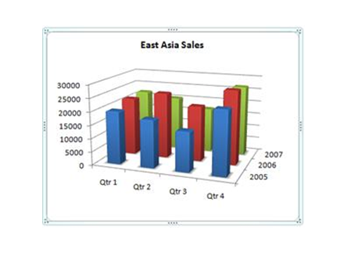
حادّ
Exaggerate: مبالغ
Perspective: المنظور

Slide 39
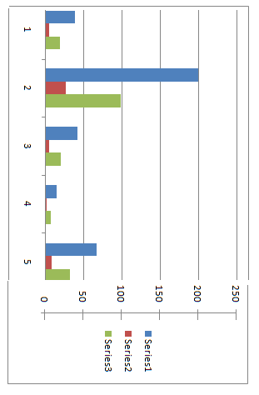

Slide 46
Grouped Frequency Distribution of a Test Scores
Classes Class Frequency
39.5-49.5 3
49.5-59.5 10
59.5-69.5 53
69.5-79.5 107
79.5-89.5 147
89.5-99.5 130
99.5-109.5 78
109.5-119.5 59
119.5-129.5 36
129.5-139.5 11
139.5-149.5 6
149.5-159.5 1
159.5-169.5 1
The first step is to create a frequency table. Unfortunately, a simple frequency table would be too big, containing over 100 rows. To simplify the table, we group scores together as shown
Lower Limit
Upper Limit

Slide 47
To create this table, the range of scores was broken into intervals, called class intervals. The first interval is from 39.5 to 49.5, the second from 49.5 to 59.5, etc. Next, the number of scores falling into each interval was counted to obtain the class frequencies. There are 3 scores in the first interval, 10 in the second, etc.
In a histogram, the class frequencies are represented by bars. The height of each bar corresponds to its class frequency. A histogram of these data is shown in next Figure.

Slide 48
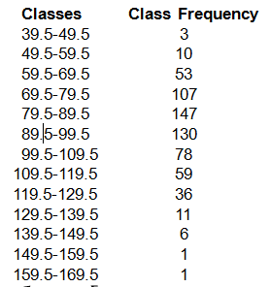
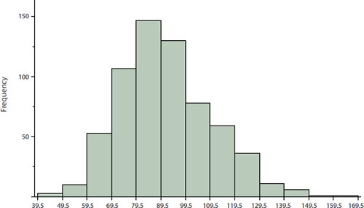

Slide 51
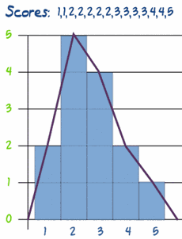
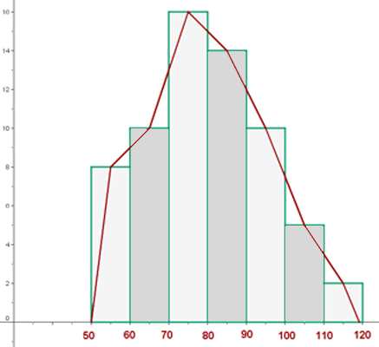
Frequency Polygon
A graph made by joining the middle-top points of the columns of a frequency histogram

Slide 52
التفرّق

