Slide 1
Education in Medical Research
CME unit
Study Design
Firas A. Alobaidi
Asst. Prof. of Orthopedic surgery

Slide 2
Aim :
1- Define Study Design in research
2- Types of Study Designs
3- Self- assessment exercises

Slide 3
Minimum requirements to be a researcher :
1- C.I.T.I ( GCP ) certificate
2- Research methodology course certificate
How to perform a study protocol ?
1- Asking a clinically important question
2- Conducting a comprehensive literature review
3- Deciding on the best study methodology
4- Eligibility criteria
5- Choosing primary and secondary outcomes
6- Sample size calculation for primary outcomes
7- Writing a study proposal
8- Obtaining ethical approval
9- Performing preliminary or pilot study
10- Obtaining research funding to start the research

Slide 4
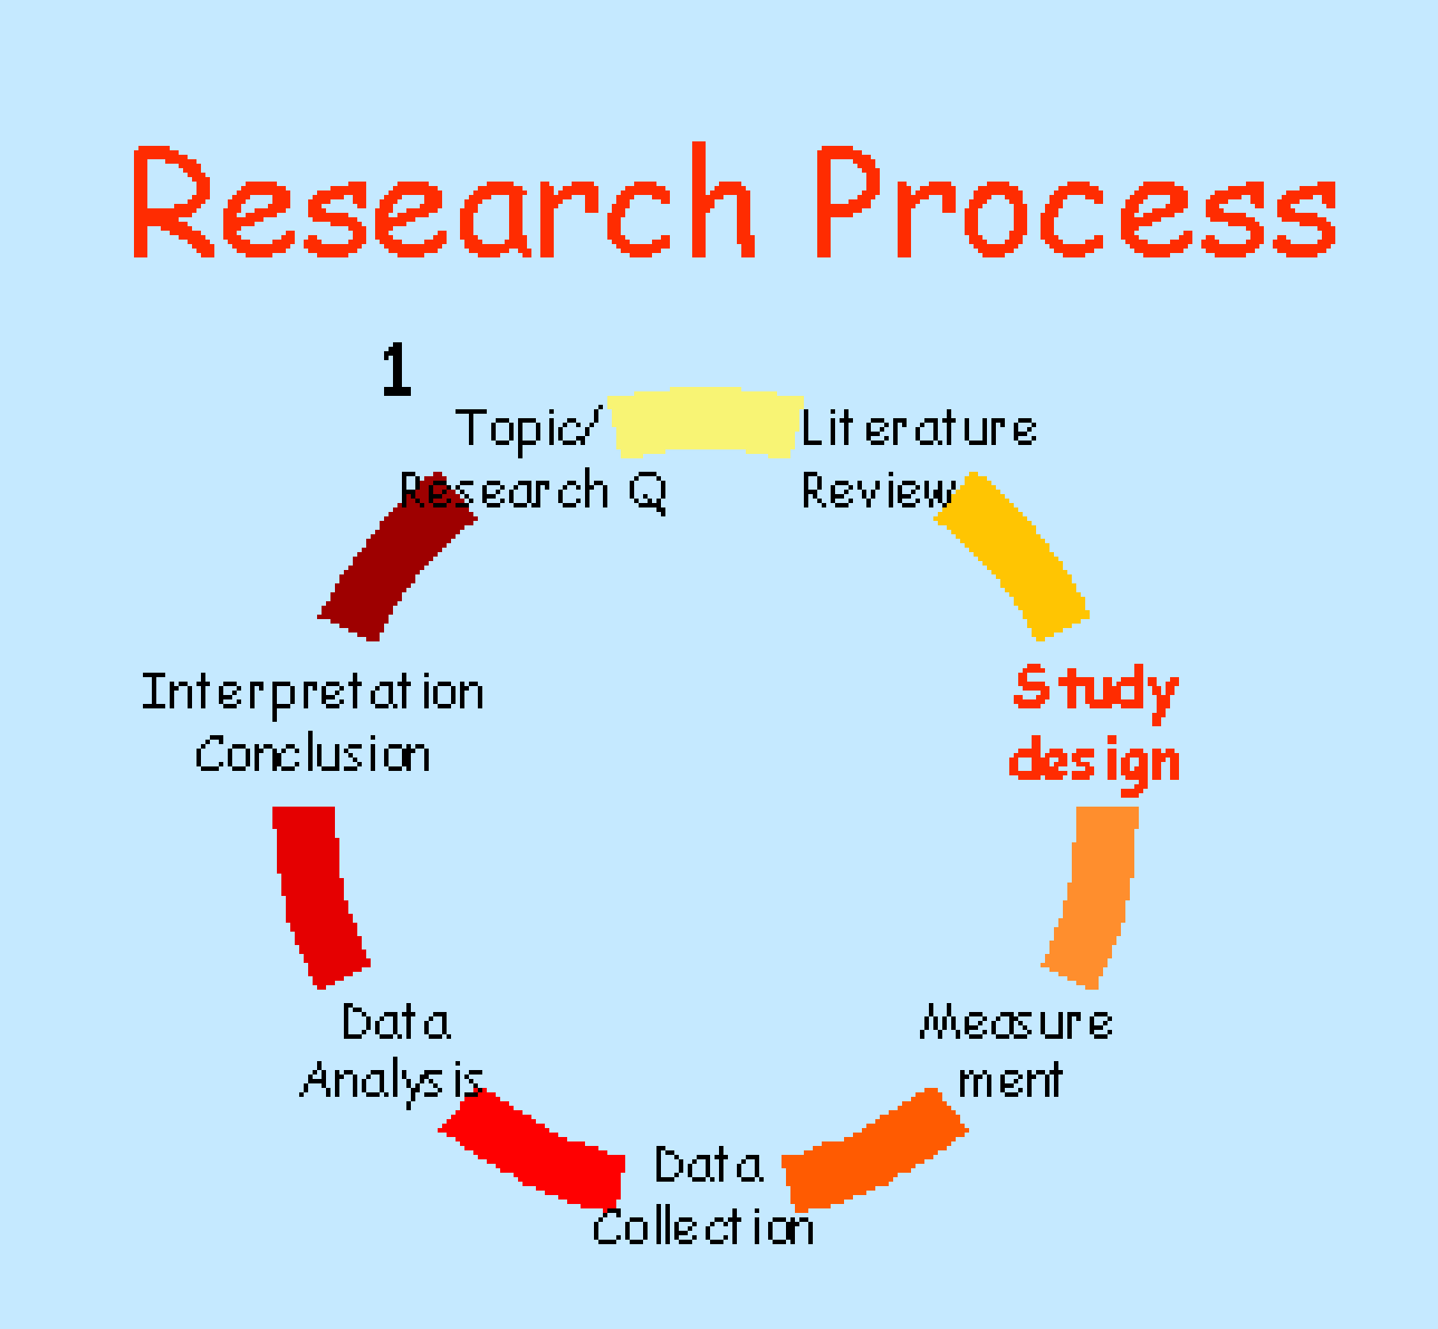
Study Design = is the procedure under which a study is
carried out.
It is the procedure by which the study question is best answered

Slide 5
Types of study designs :
Observational
Experimental
Open Trial
RCT
CT
Descriptive
Analytical
Cohort
Case Series
Cross Sectional
Case - Control
Case Report

Slide 6
Other types of study :
Audit
Survey
Systematic review and Meta-analysis

Slide 7
Observational descriptive :
The researcher reports what has been observed in a sample.
Nothing is done to the subjects in the sample.
There is no control group.
They are useful for generating hypothesis that can can be tested by using other study designs.
Case Report
Both can be prospective or Retrospective
Case Series

Slide 8
Observational analytical :
The researcher reports the similarities and differences that observed between subjects in two or more groups.
Nothing is done to the subjects in the sample.
There is control group.
Risk factor
Outcome
Cross sectional
Past
Present
Risk factor
Outcome
Case control
Risk factor
Outcome
Cohort
present
Future

Slide 9
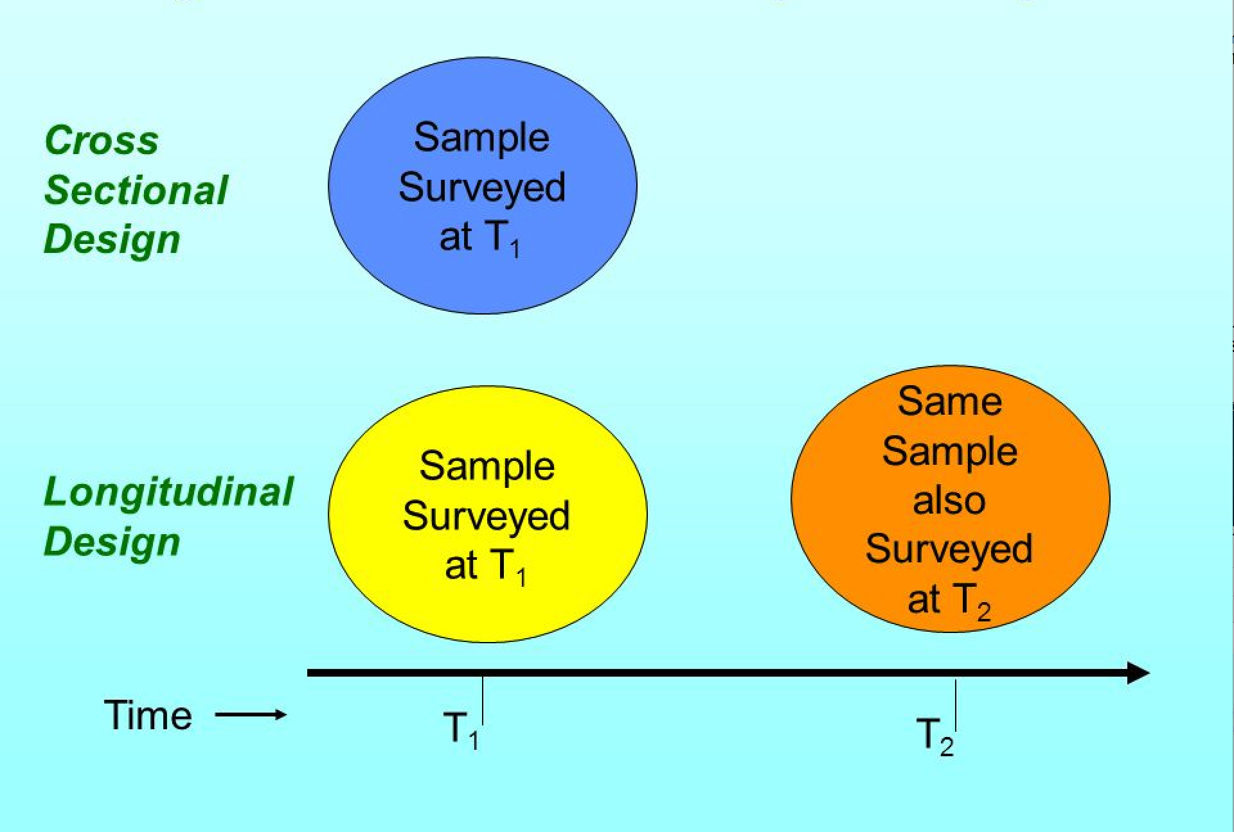

Slide 10
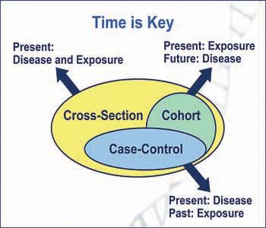

Slide 11
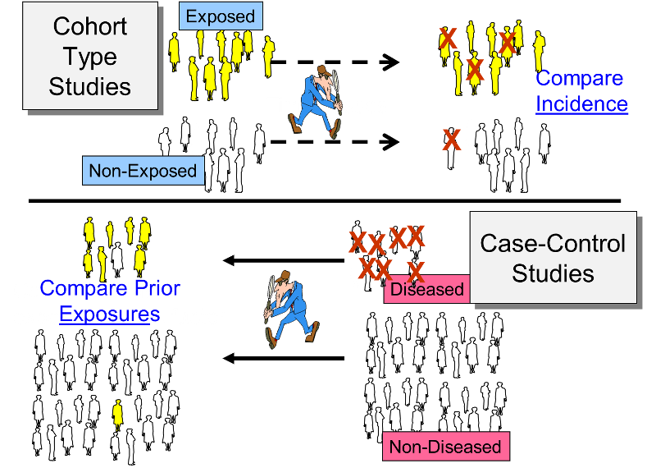

Slide 12
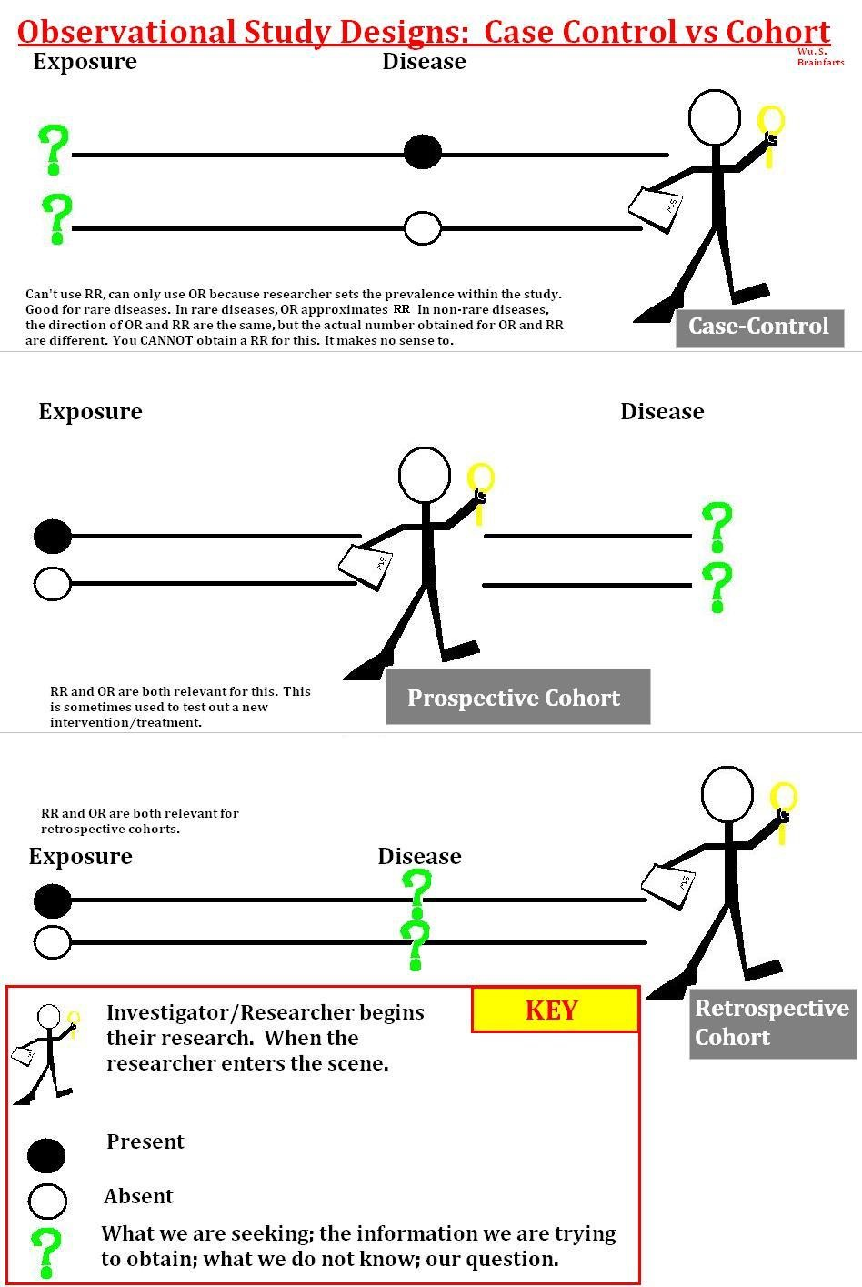

Slide 13
Experimental study designs
The researcher intervenes in some way with the experimental group and reports any differences in the outcome between this experimental group and a control group in whom no intervention or a different intervention was offered.
Open Trial :
There is no control group
Controlled Trial :
There is no Randomization, or no true randomization (Quasi-randomized trial ): e.g. randomized according to date of birth
Randomized Controlled Trial ( RCT ) :
The gold standard design for studying treatment effects.

Slide 14
Cross - over Trial :
All the subjects receive one treatment and then switch to the other treatment halfway through the study.
n-of-1 Trial :
A single subject is studied and receives repeated courses of active drug and placebo in a random order.

Slide 15
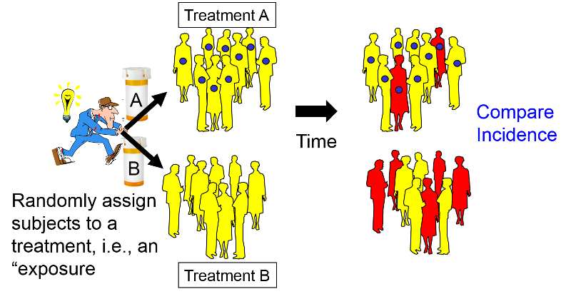
RCT : there is Randomization , Control group and Intervention

Slide 16
How to randomize ?
Random sampling VS. random allocation
1- Simple randomization : Dice , Coin
if small sample ( < 200 ), then unequal groups !
2- Block randomization :
ABAB
AABB
Rx A
Eligible patients
BABA
Rx B
BBAA
ABBA
BAAB
Never unequal by more than half block size

Slide 17
Small blocks allow guessing of next allocation
Large blocks can lead to unequal treatment groups 1/2 of the block
so variable sized blocks technique can be used
Rx A
40 / 50 D.M
sample of n = 100
Block Randomization
Rx B
5 / 50 D.M

Slide 18
3- Stratified randomization : ( in small trials n < 200 )
Rx A
Diabetic patients
Rx B
Rx A
Non diabetic patients
Rx B
BUT !!!

Slide 19
Stratification demands block randomization
if you do not block in stratification then it is the same as simple randomization
Blocked stratification
D.M
Non D.M
ABAB
BABA
BABA
BBAA
ABBA
BABA
BAAB
ABAB

Slide 20
Study of the studies :

Slide 21
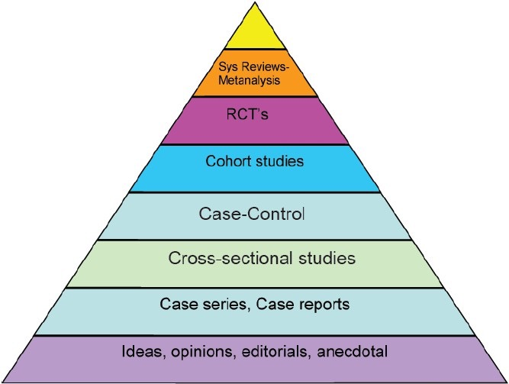
Hierarchy of evidence

Slide 22
Summary :

Slide 23
Self- assessment exercises :
What types of studies are suggested by the following statements ?
Q 1
Patients with ankle injuries who are seeing a physiotherapist are questioned about the type of trainers they wear in order to investigate the relationship between running shoes and susceptibility to ankle injuries.The answers are compared with those of healthy people.
Q 2
Builders exposed to asbestos on demolition site are seen regularly, to detect any adverse consequences.

Slide 24
Q 3
A consultant physician investigate how many patients newly referred to the outpatient clinic are seen within 16 weeks of the date of referral.
Q 4
Patients with chronic lower back pain are randomly given one of two treatments and assessed regularly.

Slide 25
Answers :
1- Case - control study.
2- Prospective cohort study.
3- Audit
4- Randomized controlled trial.
References :
1-Lee J, Norvell C, Dettori R. SMART approach to spine clinical research,AO spine ,Switzerland , 2013
2- Gosall G, Gosall N. The Doctor s Guide to critical appraisal, 2nd ed, UK, 2009
3- further sources from youtube and internet sources ( pictures)

Slide 26
Thank you

